Slide 1
Predictive Modeling for Cardiovascular Diseases
By,
Shafiq Abubacker
Data Analysis and Machine Learning Approach

Slide 2
Introduction Framingham Cardiovascular Study: Predictive Modeling for CHD Risk
The Framingham, Massachusetts, cardiovascular study aims to predict the 10-year risk of coronary heart disease (CHD) in residents.
Dataset comprises 4,000+ records with 15 attributes, rich in demographic, behavioral, and medical risk factors.
Develop a predictive model for early CHD risk identification, enabling timely intervention and personalized healthcare.

Slide 3
Project Workflow
Handle missing values, encode categorical variables, and normalize/standardize numerical features for dataset quality.
Data Preprocessing
Gain insights into variable distributions and relationships.
Identify and address outliers crucial for model performance.
Exploratory Data Analysis
Enhance predictive power through new feature creation or existing feature transformation.
Feature Engineering:
Choose common classification algorithms (logistic regression, decision trees, random forests,etc).
Split dataset into training and testing sets for evaluation.
Train models on the training set and evaluate on testing set using metrics like accuracy, precision, recall, and F1 score.
Model Selection and Training
Understand feature contributions for healthcare professionals to grasp key risk factors.
Significance in dealing with patient outcomes, ensuring alignment with existing medical knowledge
Interpretability
Final Predictive Model
Thoroughly evaluate and potentially fine-tune hyperparameters.
Provides a tool for assessing 10-year CHD risk, stratifying patients based on risk levels for prioritized interventions.
Continuous Validation and Updating
Essential as new data becomes available.
Collaboration with domain experts and healthcare professionals for continuous refinement and alignment with dynamic cardiovascular health research.

Slide 4
Data Overview
Individual Identifier:
id: Unique number for each person
Personal Information:
age: Age in years
sex: Gender (Male or Female)
Health Behaviors:
is_smoking: Smoking status (YES or NO)
cigsPerDay: Cigarettes smoked per day (may be missing)
Medical History:
prevalentStroke: Previous stroke (1 for Yes, 0 for No)
prevalentHyp: Hypertension (1 for Yes, 0 for No)
diabetes: Diabetes (1 for Yes, 0 for No)
Health Measures:
totChol: Total cholesterol (may be missing)
sysBP: Systolic blood pressure
diaBP: Diastolic blood pressure
BMI: Body mass index (may be missing)
heartRate: Heart rate (one missing value)
glucose: Glucose level (many missing values)
Target Variable:
TenYearCHD: Coronary heart disease in the next 10 years (1 for Yes, 0 for No)
Missing Values: Several features have missing data, requiring appropriate handling.
Target Variable: The goal is to predict 10-year CHD risk based on other features.
Data Types:
Integer: id, age, disease indicators
Float: education, health measures
Object: sex, smoking status

Slide 5
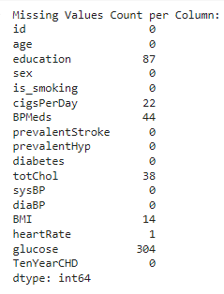
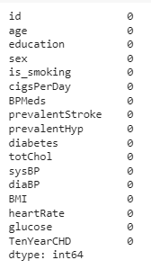
Data Pre-processing
Replaced missing values in numerical columns with the median.
Replaced missing values in categorical columns with the mode
Checked for duplicate values in the dataset and found there were no duplicates

Slide 6
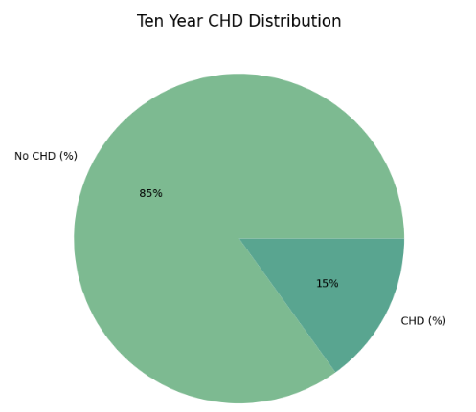
Exploratory Data Analysis (EDA)
Distribution of Ten-Year Coronary Heart Disease (CHD) Risk in the Dataset

Slide 7
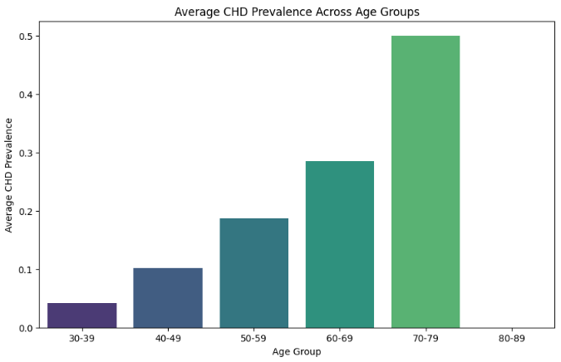
Exploratory Data Analysis (EDA)
Relationship Between Age and Ten-Year Coronary Heart Disease (CHD) Risk

Slide 8
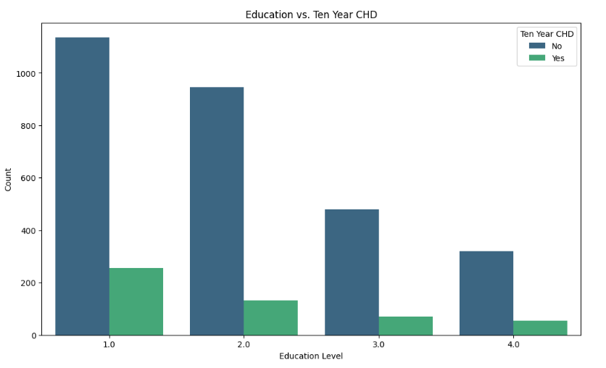
Exploratory Data Analysis (EDA)
Exploring the Relationship Between Education and Coronary Heart Disease Risk

Slide 9
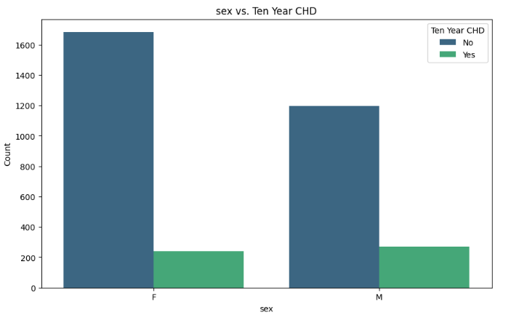
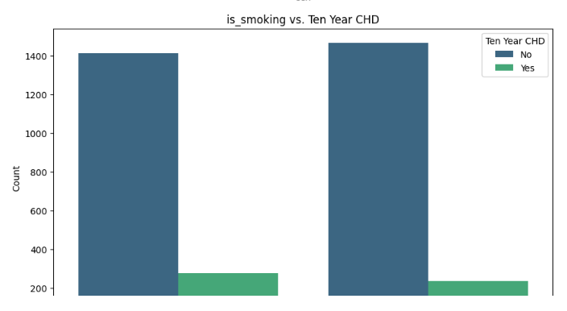
Exploratory Data Analysis (EDA)
Categorical Variables Distribution

Slide 10
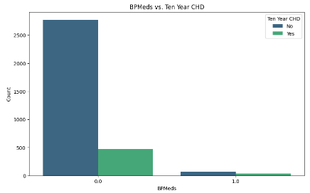
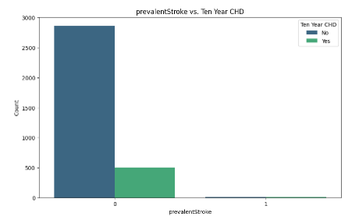
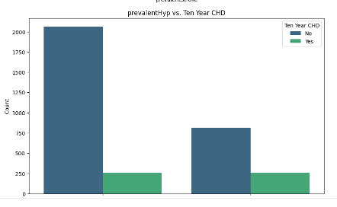
Exploratory Data Analysis (EDA)
Categorical Variables Distribution

Slide 11
Exploratory Data Analysis (EDA)
Categorical Variables Distribution
In the 'is_smoking' column, the distribution is relatively even. However, other health-related columns like 'BPMeds,' 'prevalentStroke,' 'prevalentHyp,' and 'diabetes' exhibit imbalances, with fewer positive cases.
The 'TenYearCHD' column also shows an imbalance, indicating a lower count for positive cases compared to negative cases.
Total cholesterol and BMI distributions are similar, suggesting a potential linear relationship. This could be helpful for understanding how these two health metrics influence each other.
Glucose distribution is highly right-skewed with many outliers. These outliers represent individuals with significantly higher glucose levels than the majority.

Slide 12
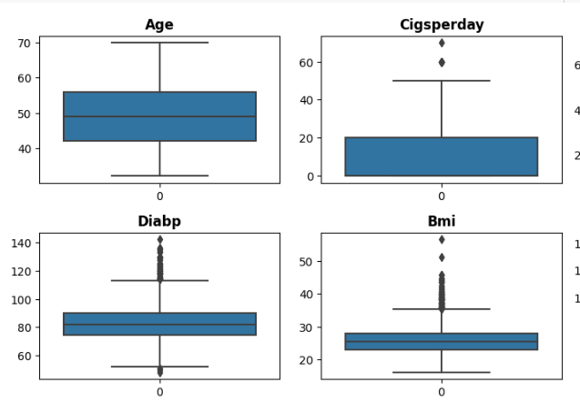
Exploratory Data Analysis (EDA)
Numeric Feature Distributions Through Box Plots
Cigarettes Per Day: Right-skewed, majority smokes less, potential high-smoking outliers.
Diastolic Blood Pressure: Symmetrical, no major outliers.
Body Mass Index: Right-skewed, majority lower BMI, potential high-BMI outliers.

Slide 13
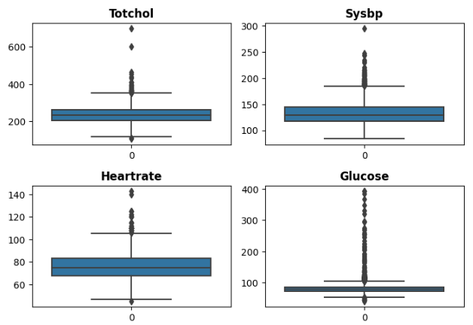
Exploratory Data Analysis (EDA)
Numeric Feature Distributions Through Box Plots
Total Cholesterol: Skewed, potential high-cholesterol outliers
Systolic Blood Pressure: Slightly right-skewed, potential high-pressure outliers.
Heart Rate: Skewed, potential high-heart-rate outliers.
Glucose: Highly right-skewed, majority with lower levels, potential high-glucose outliers.

Slide 14
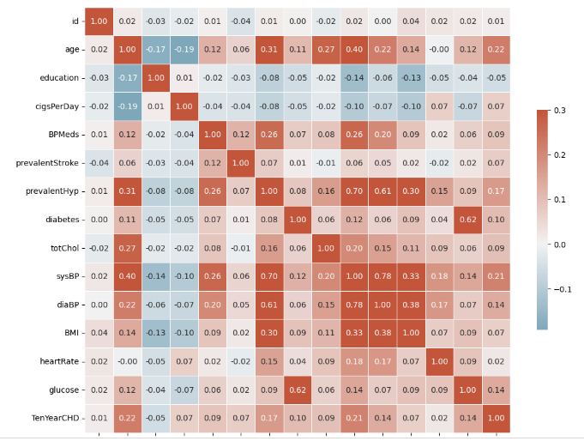
Exploratory Data Analysis (EDA)
Strong positive correlation: Systolic and diastolic blood pressure have a strong positive correlation, meaning they tend to increase or decrease together.
Moderate positive correlation: Diabetes and glucose have a moderate positive correlation (0.62), suggesting a tendency for higher glucose levels with diabetes.
Negligible influence: Education level doesn't appear to be significantly correlated with CHD, implying it likely has little influence on CHD risk and can be dropped from the analysis.

Slide 15
Hypothesis Testing
Hypothetical Statement – 1
Null Hypothesis (H0):No CHD risk: Average age?
Alternative Hypothesis (H1):
CHD risk: Different average age?
Hypothetical Statement – 2
Null Hypothesis (H0): SysBP vs DiaBP: No Correlation
Alternative Hypothesis (H1):
SysBP vs DiaBP: Correlation
Hypothetical Statement – 3
Null Hypothesis (H0): No age difference vs stroke.
Alternative Hypothesis (H1):
Age difference vs stroke
Two-sample independent t-test
Pearson correlation coefficient test
Two-sample independent t-test
T-statistic: 13.771446174098248
P-value: 1.8455541117753288e-38
Pearson Correlation Coefficient: 0.7819075063169498
T-statistic: 3.4424169317511253
P-value: 0.0005835249029062626
REJECT NULL HYPOTHESIS

Slide 16
Feature Engineering
Outlier Handling Using Row Removal
Extreme values in specific features were removed to ensure data representativeness.
Thresholds were set based on domain knowledge and medical guidelines:
Cigarettes/day > 50
Diastolic BP > 140
Systolic BP > 250
BMI > 50
Heart rate > 130
Glucose > 300
Total cholesterol > 500
Label Encoding for Categorical Variables:
Categorical variable has ordinal relationship (meaningful order).
Assigns unique integers to categories based on their order.

Slide 17
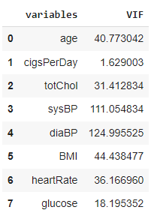
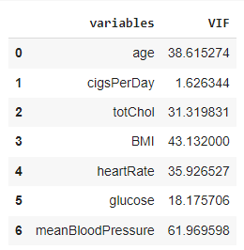
Feature Manipulation VIF Technique
Combining sysBP and diaBP into meanBloodPressure didn't resolve the issue.
High VIF Values Suggest Multicollinearity:
Variables with high VIF:
age, cigsPerDay, totChol, sysBP, diaBP, BMI, heartRate, glucose
VIF values for meanBloodPressure remain high.
Explore additional feature engineering or selection techniques to address multicollinearity.

Slide 18
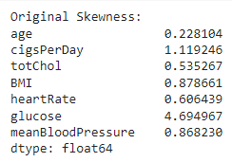
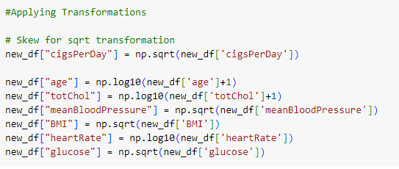
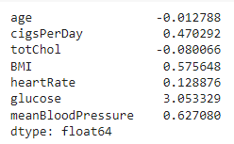
Skewness Correction

Slide 19
Scaling Data
Focused on critical health parameters: age, cigarettes per day, total cholesterol, mean blood pressure, BMI, heart rate, and glucose.
Applied Z-score normalization using StandardScaler to standardize feature values.
Ensures data transformation with a mean of 0 and a standard deviation of 1.

Slide 20
Data Splitting & Handling Imbalanced Dataset
Strategic Splitting:
80% training set for model learning.
20% test set for unbiased performance evaluation.
Balances model training with generalization assessment.
Addressing Imbalance:
SMOTE oversamples minority class to create synthetic samples.
Tomek links remove overlapping instances to improve class separation.
SMOTE's Purpose:
Counteracts class imbalance by generating additional minority class data.
Tomek Links' Purpose:
Enhances class distinction by eliminating potentially confusing instances.

Slide 21
Model Implementation
Model Selection:
Logistic Regression - A linear model used for binary classification, estimating the probability of an instance belonging to a particular class.
Decision Tree - A tree-like model that recursively splits data based on feature conditions to make decisions or classifications.
Random Forest- An ensemble of decision trees that aggregates their predictions to improve accuracy and robustness.
SVM - A model that finds a hyperplane to separate data into classes, maximizing the margin between them in a high-dimensional space.
XGBoost - An efficient gradient boosting algorithm that sequentially builds a series of weak learners to enhance predictive performance.
Naive Bayes - A probabilistic classification algorithm based on Bayes' theorem, assuming independence between features for simplicity.

Slide 22
Model Comparison
Model | Accuracy | Precision (Class 1) | Recall (Class 1) | F1-Score (Class 1)
Logistic Regression | 0.642 | 0.27 | 0.75 | 0.4
Decision Tree | 0.813 | 0.31 | 0.15 | 0.2
KNN | 0.663 | 0.21 | 0.42 | 0.28
Random Forest | 0.786 | 0.22 | 0.13 | 0.16
SVM | 0.623 | 0.27 | 0.78 | 0.4
XGBoost | 0.717 | 0.27 | 0.48 | 0.35
Naive Bayes | 0.69 | 0.28 | 0.61 | 0.38
Decision Tree: Highest accuracy but risks overfitting due to lower precision and recall.
Random Forest: Balanced precision and recall, sacrificing some accuracy compared to Decision Tree.
XGBoost: Good balance across all metrics (accuracy, precision, recall).
Naive Bayes: Decent accuracy with balanced metrics, simpler to implement.
KNN: Moderate accuracy, falls behind top performers in precision and recall.
Logistic Regression: Lowest accuracy, similar imbalance as SVM.

Slide 23
Hyperparameter Tuning
GridSearchCV for Hyperparameter Tuning
Systematically evaluates all possible hyperparameter combinations within a defined grid.
Ensures reliable performance estimates by training and testing on different data folds.
Logistic Regression - Hyperparameter Optimization
Best Hyperparameters:
C: 0.01
Penalty: 'l2'
Solver: 'liblinear‘
Performance Improvement:
Accuracy: 0.642 (Before) → 0.642 (After)
Precision (Class 1): 0.27 → 0.2724
Recall (Class 1): 0.75 → 0.7570
F1-Score (Class 1): 0.4 → 0.4138
Decision Tree - Hyperparameter Tuning
Best Hyperparameters:
Criterion: 'gini'
Max Depth: None
Min Samples Split: 2
Performance Improvement:
Accuracy: 0.813 (Before) → 0.8131 (After)
Precision (Class 1): 0.31 → 0.3137
Recall (Class 1): 0.15 → 0.1495
F1-Score (Class 1): 0.2 → 0.2031
KNN - Hyperparameter Tuning
Best Hyperparameters:
N Neighbors: 5
Weight Function: 'uniform'
Algorithm: 'auto‘
Performance Improvement:
Accuracy: 0.663 (Before) → 0.6632 (After)
Precision (Class 1): 0.21 → 0.2143
Recall (Class 1): 0.42 → 0.4206
F1-Score (Class 1): 0.28 → 0.2824

Slide 24
Model Selection
Naive Bayes
Strengths:
Interpretability with probability-based predictions.
Fast training, even with large datasets.
Requires minimal hyperparameter tuning.
Weaknesses:
Sensitive to assumptions about feature independence.
Lower accuracy compared to sophisticated algorithms.
Recommendation:
Choose Naive Bayes for interpretability, fast training, and simplicity when accuracy is acceptable.
XGBoost
Strengths:
High accuracy and predictive power.
Handles complex data and non-linear relationships.
Regularization features for preventing overfitting.
Scalability for efficient processing of large datasets.
Weaknesses:
Challenges in interpretability.
Computational complexity, especially for large datasets.
Recommendation:
Choose XGBoost for the highest accuracy, complex data, and scalability.

Slide 25
Conclusion
Data Overview:
Information on health parameters like age, sex, cholesterol, blood pressure, BMI, and lifestyle.
Handled missing values, treated outliers, and encoded categorical variables.
EDA Insights:
Revealed distribution patterns, correlations, and potential risk factors for cardiovascular diseases.
Machine Learning Models:
Implemented Logistic Regression, Decision Trees, Random Forest, SVM, XGBoost, and Naive Bayes.
Model Evaluation:
XGBoost showed a Good performance with an accuracy of 71.7%
Imbalanced Dataset:
Addressed imbalance using SMOTE to enhance model performance.
Key Factors:
Age, blood pressure, and cholesterol identified as critical contributors.
Recommendations:
Focus on individuals with advanced age, high blood pressure, and abnormal cholesterol for early intervention and preventive measures.

